Slide 1
Monday Feb 17th
Engineering Interactive Visual Interfaces for Data Science
“The CS Data Vis Class”
Dr. Jillian Aurisano
Plan for today:
Logistics (5 min)
Interaction
Interaction re-design activity

Slide 2
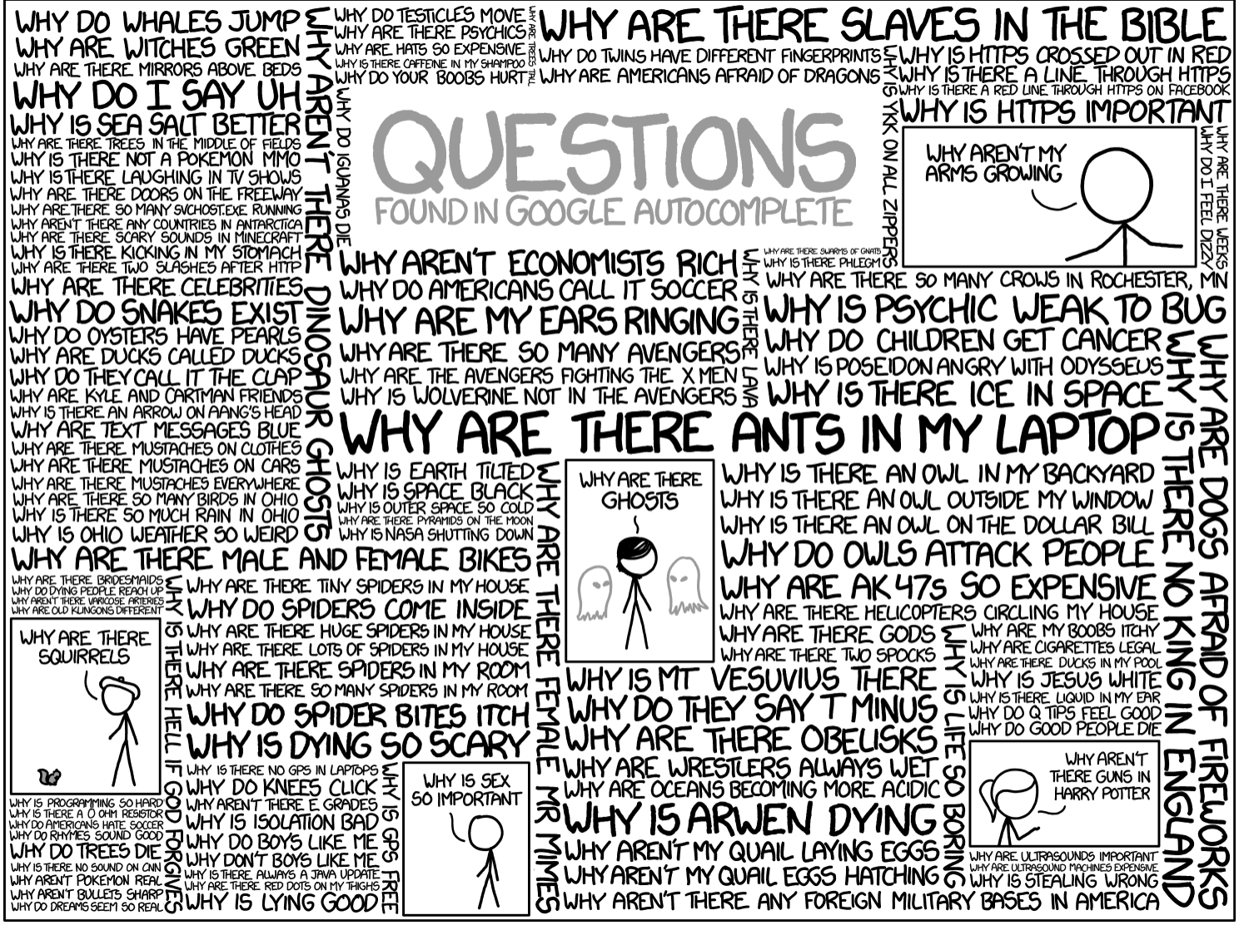
Questions?

Slide 3
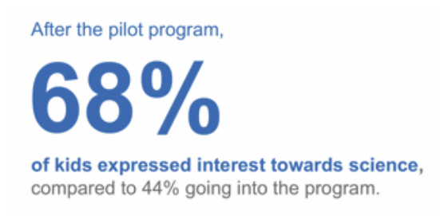
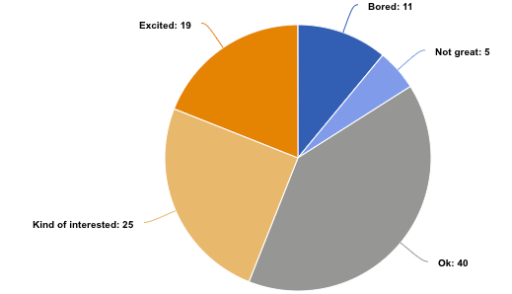
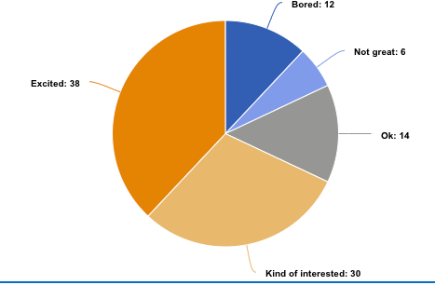
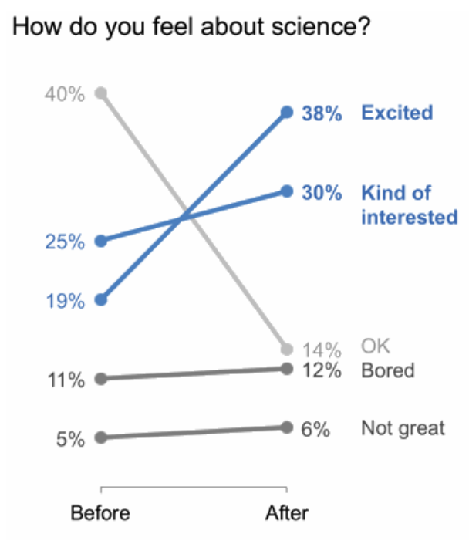
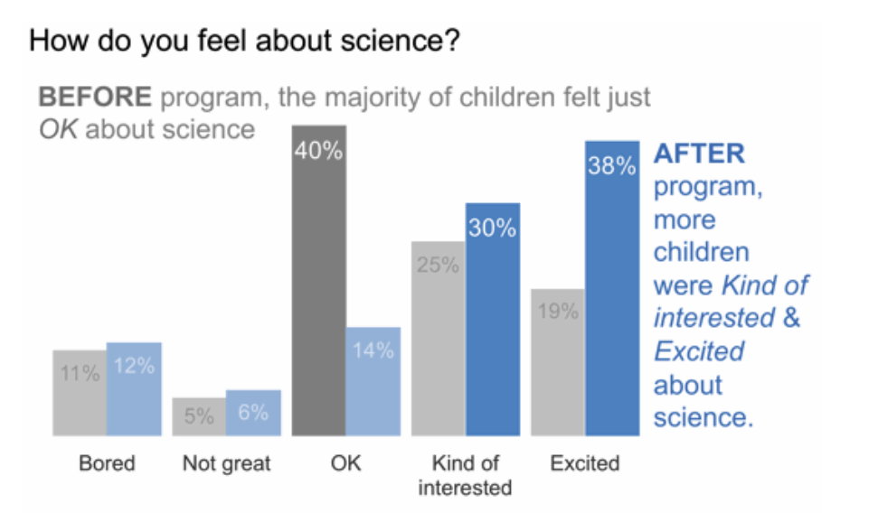
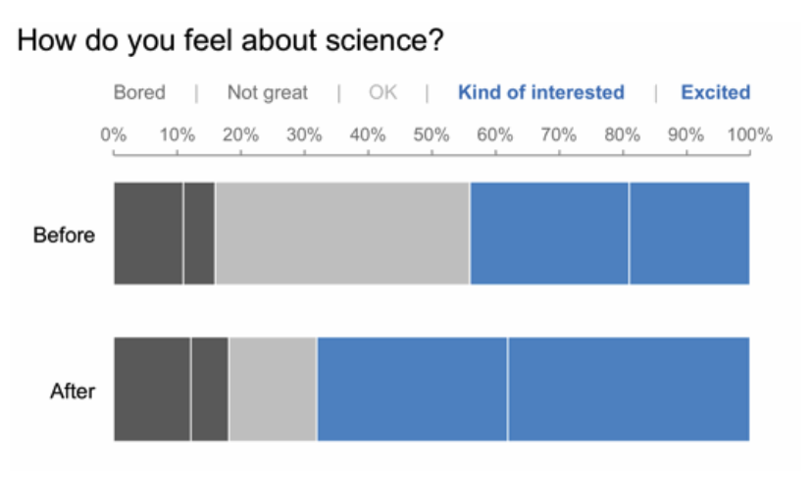
Visual design principles: Lots of design choices, don’t fixate on one
Even for ‘simple’ data

Slide 4
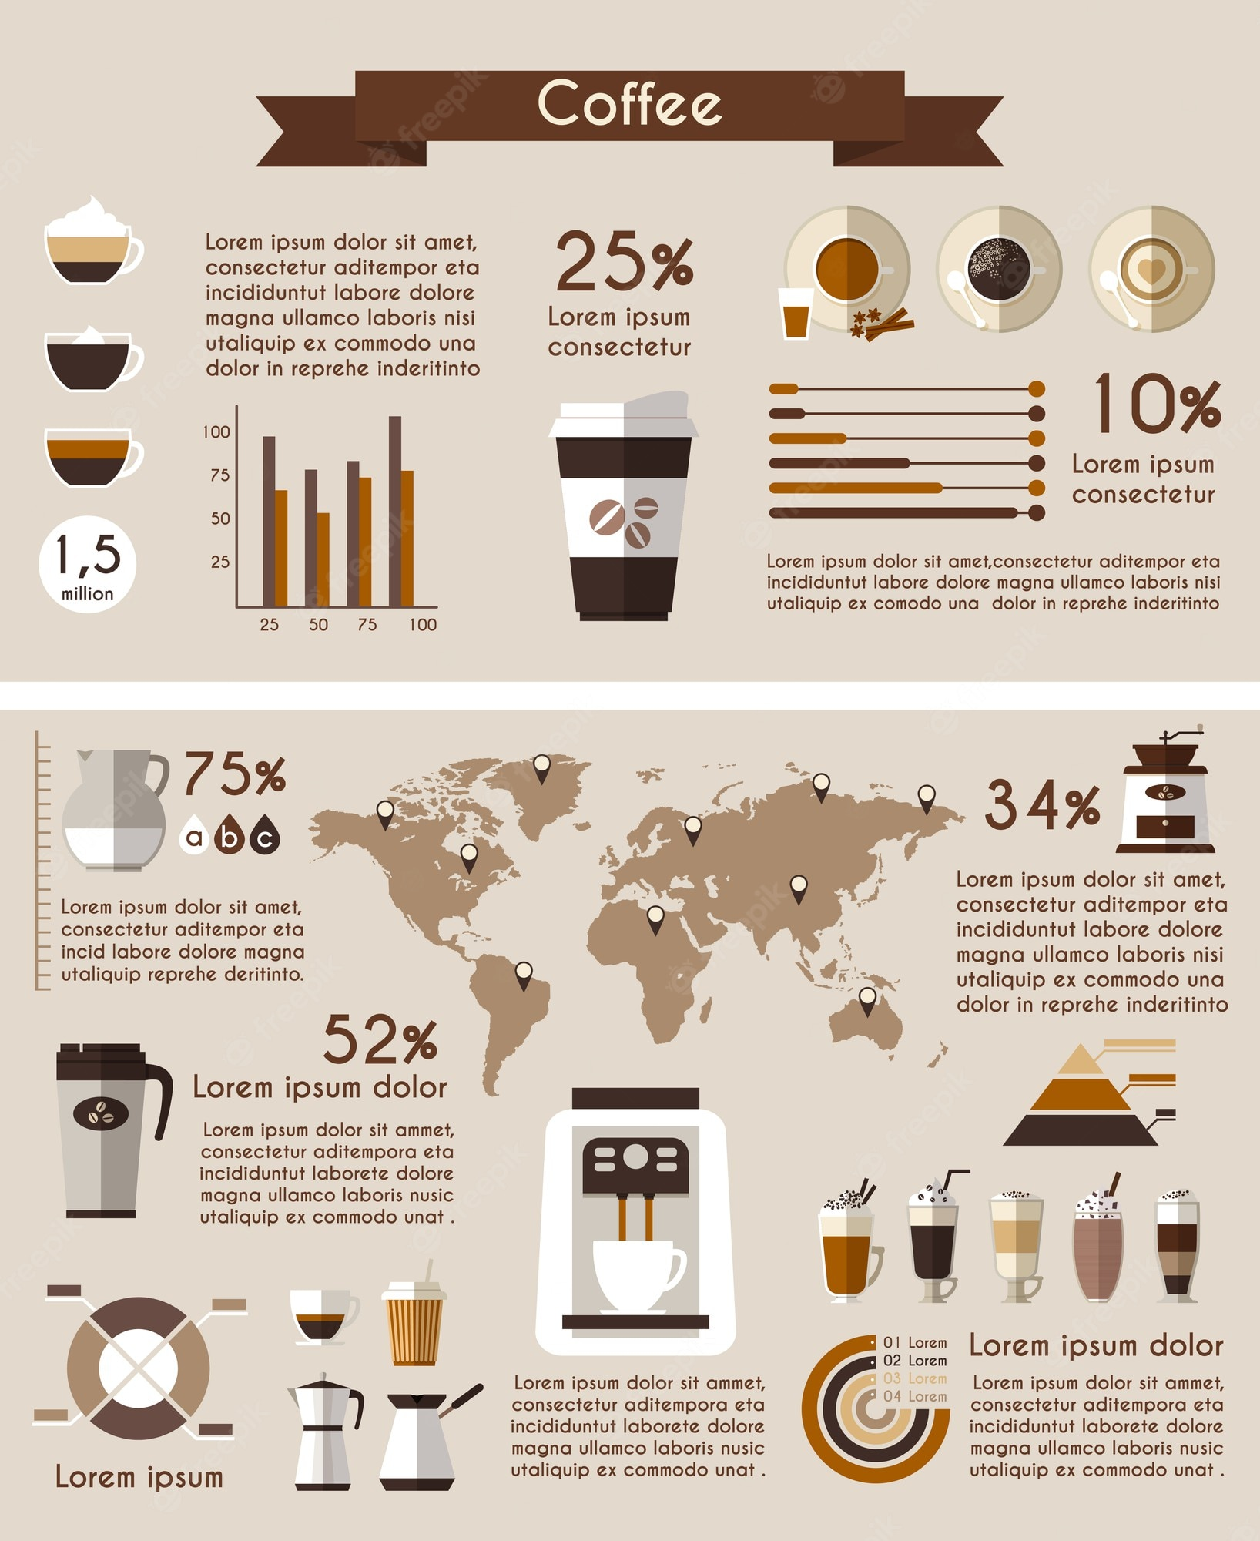
Interactivity spectrum
Static content
Infographics
A designer has curated data, encoded it in a fixed set of graphics and crafted a fixed narrative
These can be used for communication, but not exploration

Slide 5

Interactivity spectrum
Static content
Infographics
Dynamic content
Animated content
Autoplay, user not in control
Interactive content
Changes are the result of user actions

Slide 6
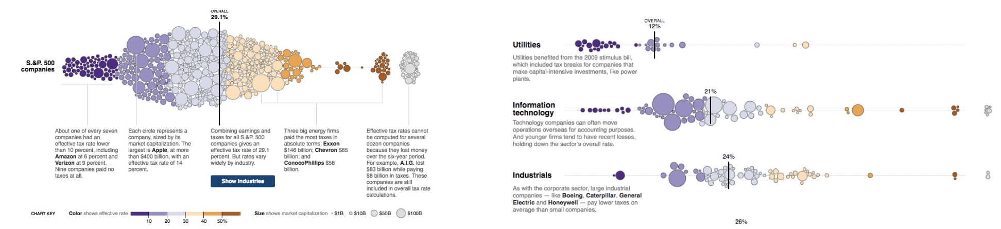
Why interact?
Data is too big/complex to fit in one view
More than one way to show it
https://archive.nytimes.com/www.nytimes.com/interactive/2013/05/25/sunday-review/corporate-taxes.html

Slide 7

Why interact with visualizations?
Interaction amplifies cognition
We understanding things better when we can touch them, manipulate them, observe cause and effect
Just like how children learn
Image you are crafting a little universe, making the laws, and you want your user to learn about the data based on their actions

Slide 8
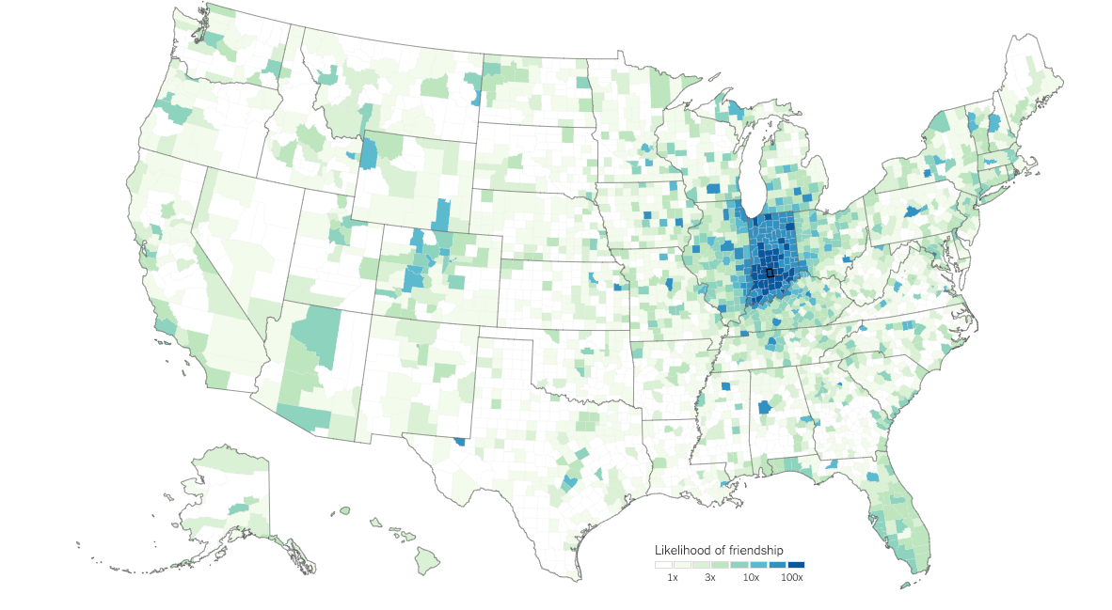
Why interact with visualizations
Manipulation allows us to understand the data
See cause and effect
when I make this change, the visualization updates to show the effect
Example:
Pose and test hypotheses
I wonder if this idea is true, let me ask by manipulating the view
Example: https://www.nytimes.com/interactive/2018/09/19/upshot/facebook-county-friendships.html
As I move my mouse across states from the coast to the middle of the country, the view updates. I connect my actions to the differences in the data.
Are counties in Ohio more connected to counties across the country than Indiana?

Slide 9

Why interact with visualizations?
Image you are crafting a little universe, making the laws, and you want your user to learn about the data based on their actions

Slide 10
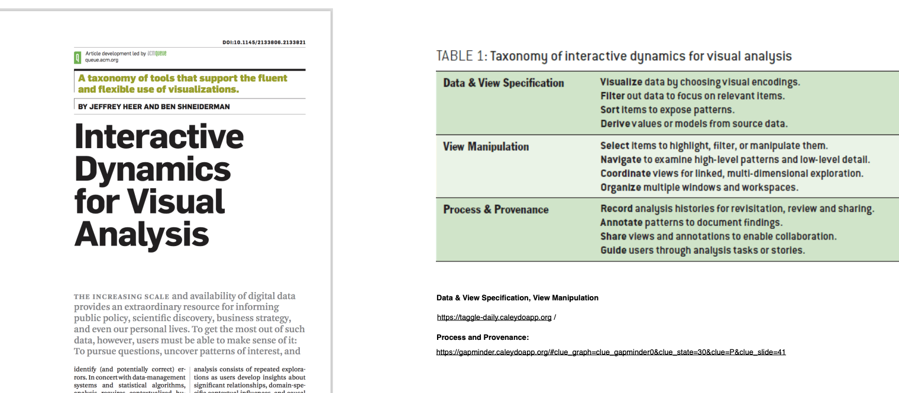
Why interact with visualization

Slide 11
Types of Interaction
Single view interaction techniques
The Visual Information Seeking Mantra
Focus+Context
Direct manipulation
Animated transitions
Navigation
Filtering and Querying
Multiple view interaction techniques
Selection (Details on Demand)
Linking and brushing
Adapting representations

Slide 12
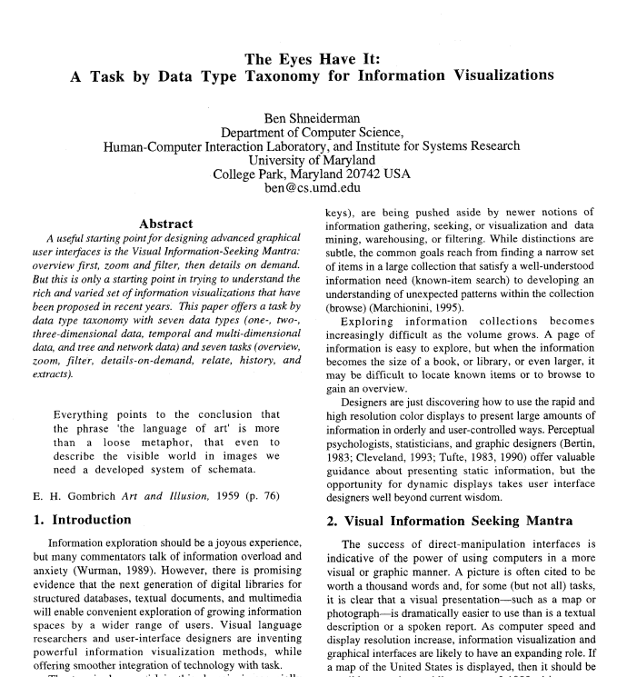
“The Mantra” The visual information seeking mantra
Overview first
Zoom and filter
Details on demand

Slide 13
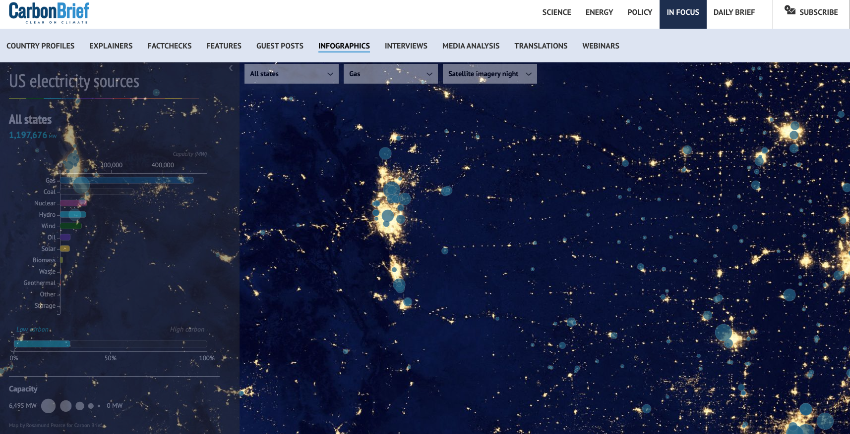
Mantra example
https://www.carbonbrief.org/mapped-how-the-us-generates-electricity/
Overview
Filter on one energy type
Zoom in to a region
Select an interesting point for details

Slide 14
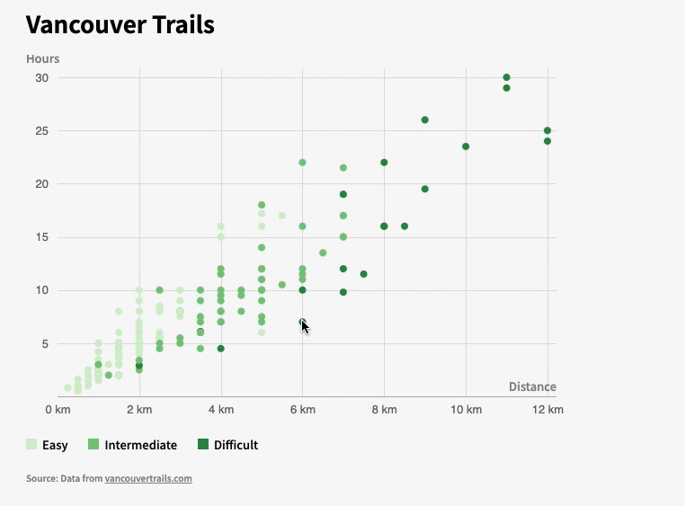
Applies to non-maps
Remember our scatterplot

Slide 15
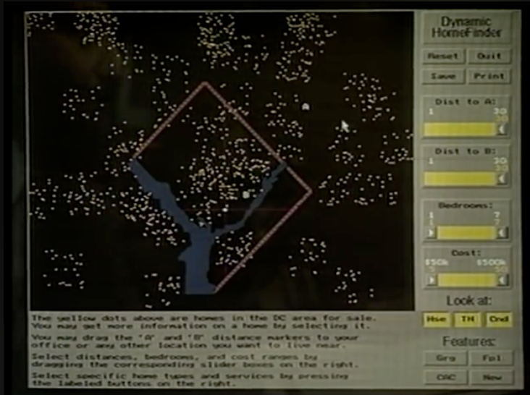
Early example of this
https://www.youtube.com/watch?v=5X8XY9430fM

Slide 16
Why “The Mantra”
Overview first
orients the user to the data
Zoom and filter
Allows the user to reduce the volume of visual information
User can change what is shown based on their interests
Zooming, is seeing a region in the data that interests you, and focusing there
Filtering, is removing extraneous data, to see the data you are interested in
Details on demand
Allows the user to get details, selecting points of interest
Avoid visual clutter

Slide 17
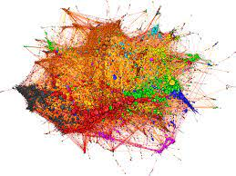
Visual Information Seeking Mantra doesn’t always work very well
What if you can’t create a visually meaningful overview as a starting point?
What if zooming to one area in your visualization doesn’t bring relevant information into focus?
Need another paradigm…

Slide 18
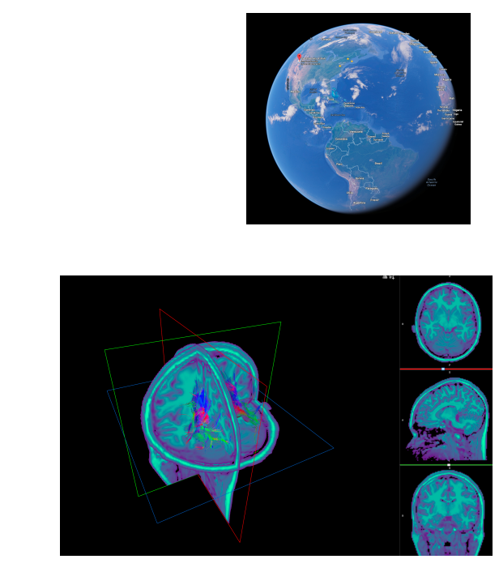
Navigation
Pan
Move around
Zoom
Enlarge and make smaller
Rotate
Showing a different region of the dataset
From a different angle
With different levels of detail

Slide 19
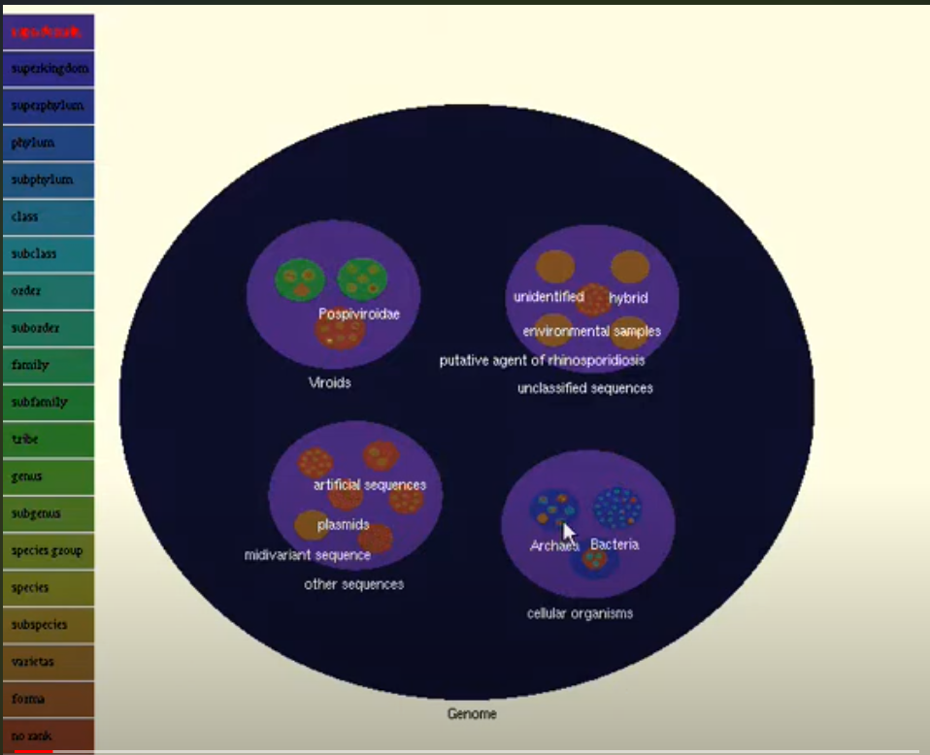
Semantic Zooming
As you zoom in, content is updated
Not just more details on zoomed out content
But different content, as you get closer
https://www.youtube.com/watch?v=d2xWEKtVv3s

Slide 20
Navigate through data as a story
Scroll through a page to tell a story
Progressively show more information
Move between states, to tell a story with the data
Add story telling elements to give the user more detailed information
Nice- has become very popular in journalism

Slide 21
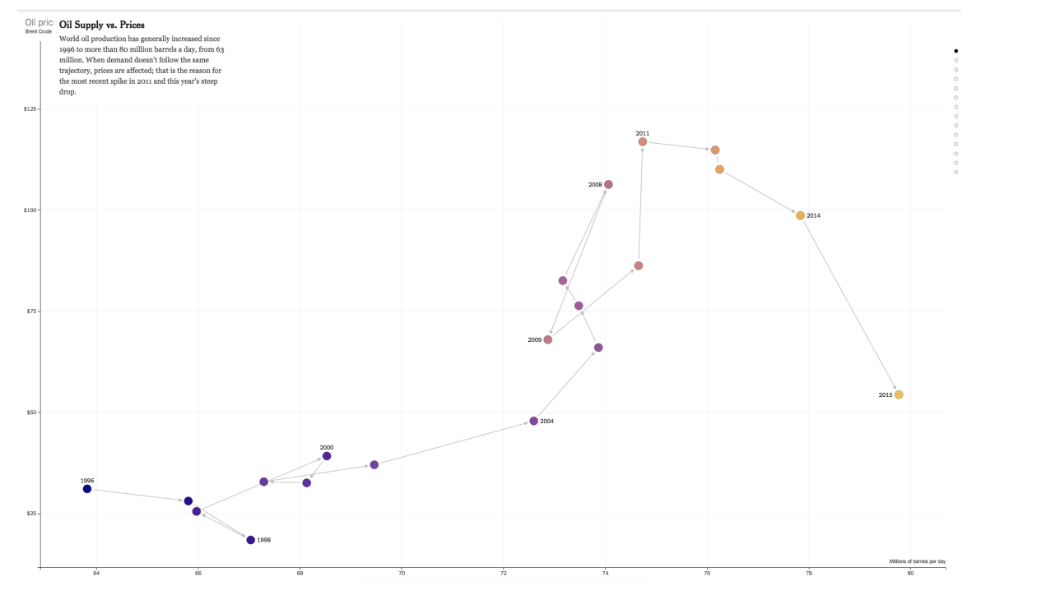
Example: Oil prices
https://www.nytimes.com/interactive/2015/09/30/business/how-the-us-and-opec-drive-oil-prices.html?_r=0

Slide 22
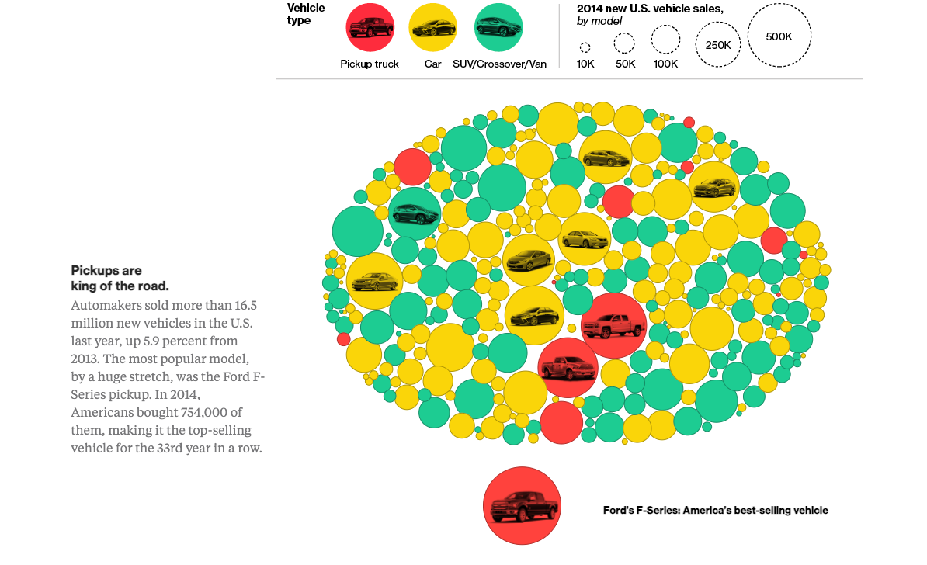
Second example
https://www.bloomberg.com/graphics/2015-auto-sales/

Slide 23
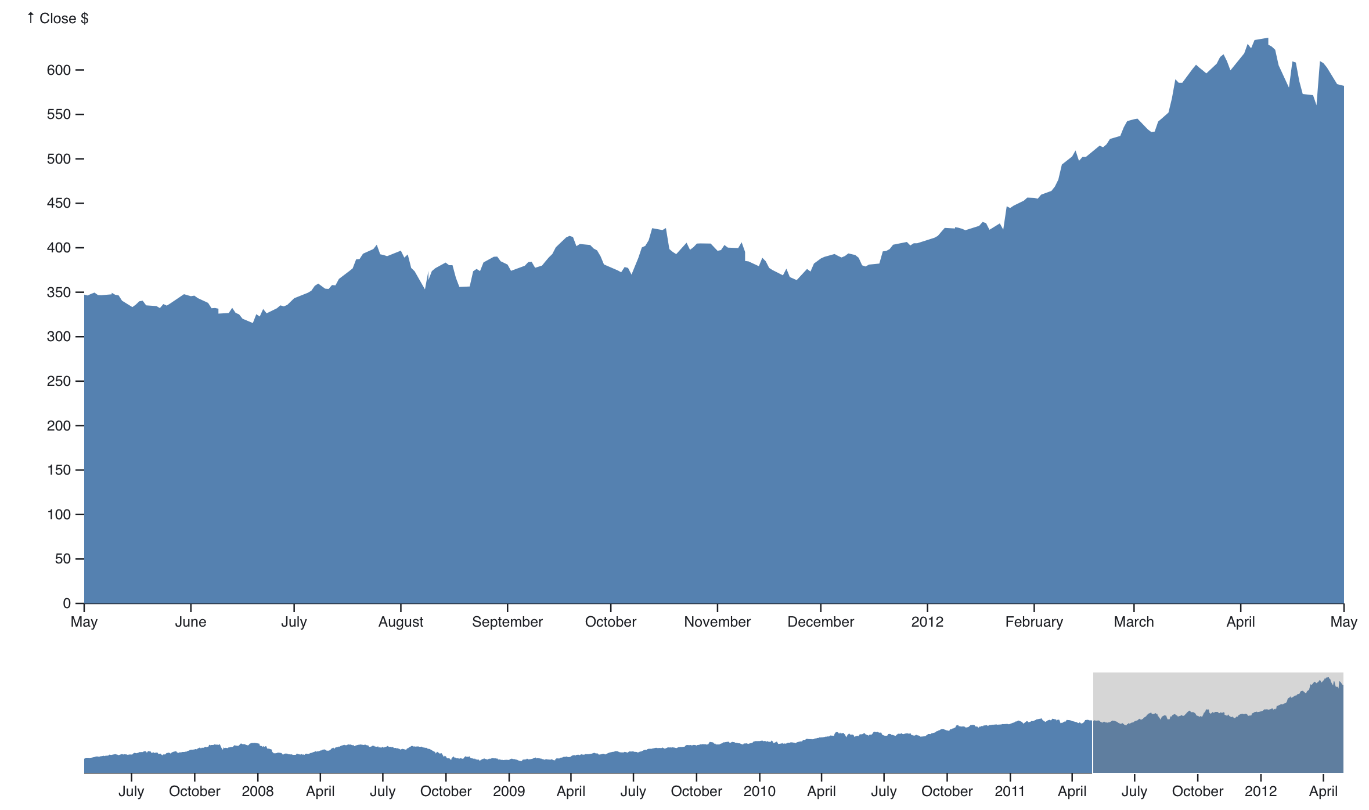
Focus + Context
User selects a region of interest (focus)
Navigation
Or selection
Selection is shown in more detail, but context is maintained
Contrast this with:
Google maps, you zoom in, and you lose a sense of where you are in the global map

Slide 24
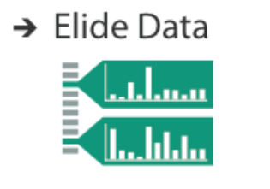
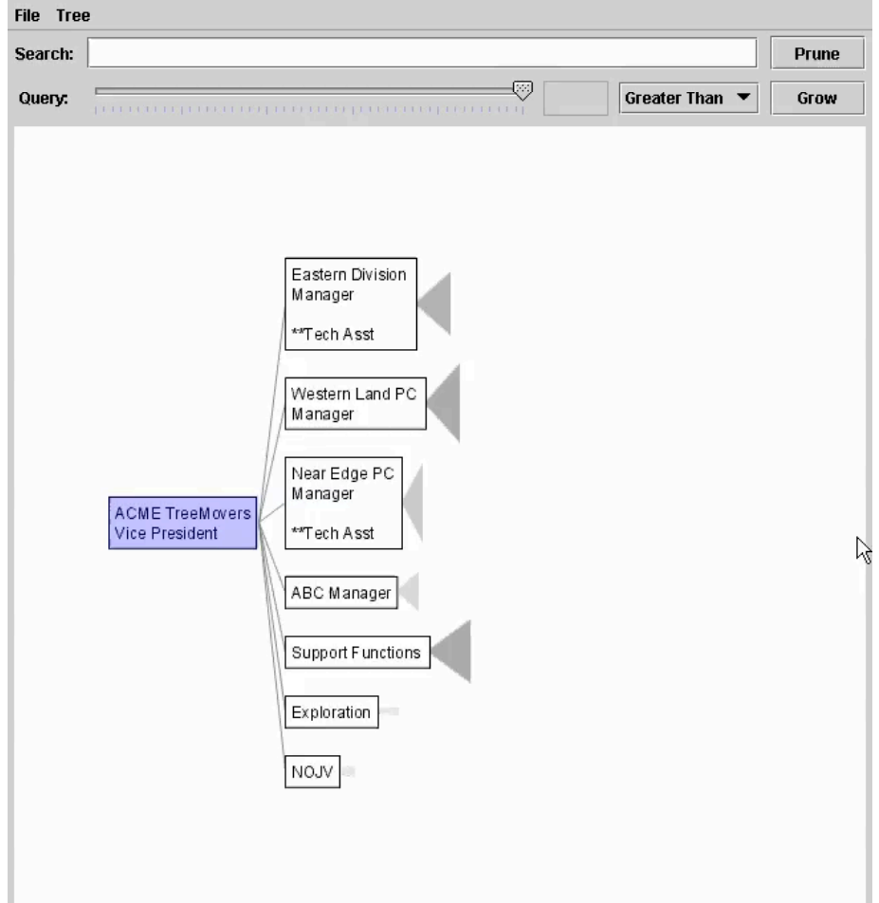
Elision
Focus item is shown in detail
Other items are summarized for context

Slide 25
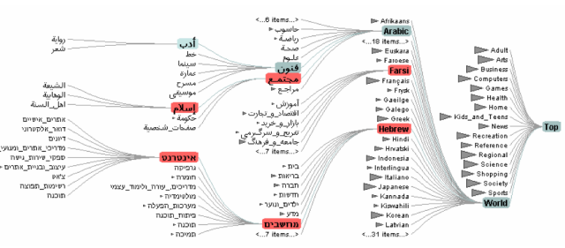
Degree of Interest (DOI)
Imagine if we tried to show a whole tree?
Too big
Too much info
Alternative:
Show parts of the tree (focus) within the whole tree (context)
Use a degree of interest function to decide what to show
DOI(x) = API(x) – D(x,y)
API: a priori interest
D: distance function to the current focus
DOI Tree
https://www.youtube.com/watch?v=RTQ0N4QY0yc

Slide 26
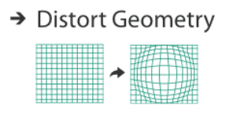
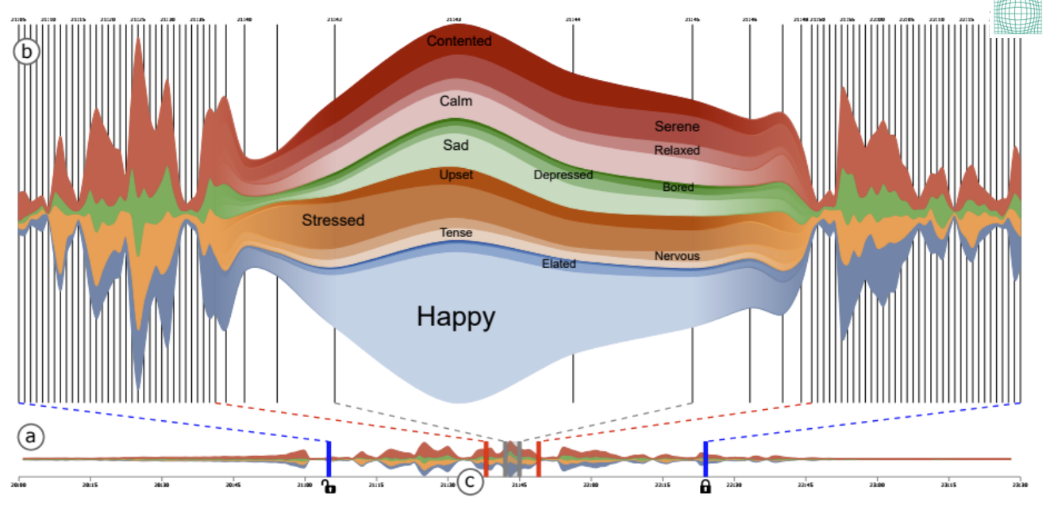
Focus+Context through Distortion
Rather than selectively collapse/expand
Instead show the area of interest in a expanded geometry, shrinking everything else
http://advanse.lirmm.fr/multistream/

Slide 27
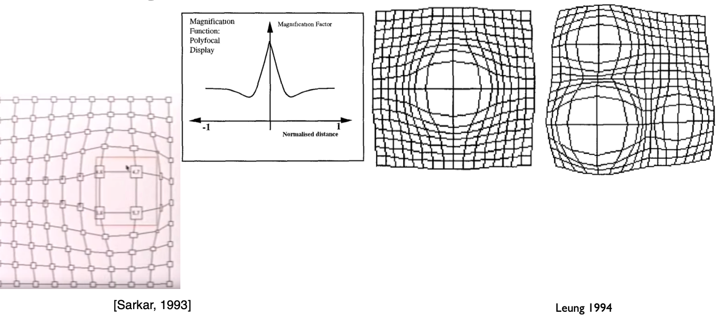
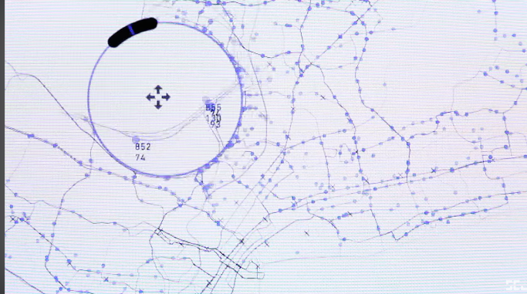
Focus+Context Fisheye
Magnify within a circular region
Distorts what is outside
Forms a ‘fish eye’
Can have a function compute the distortion
https://www.youtube.com/watch?v=P_XBL5hYiqQ

Slide 28
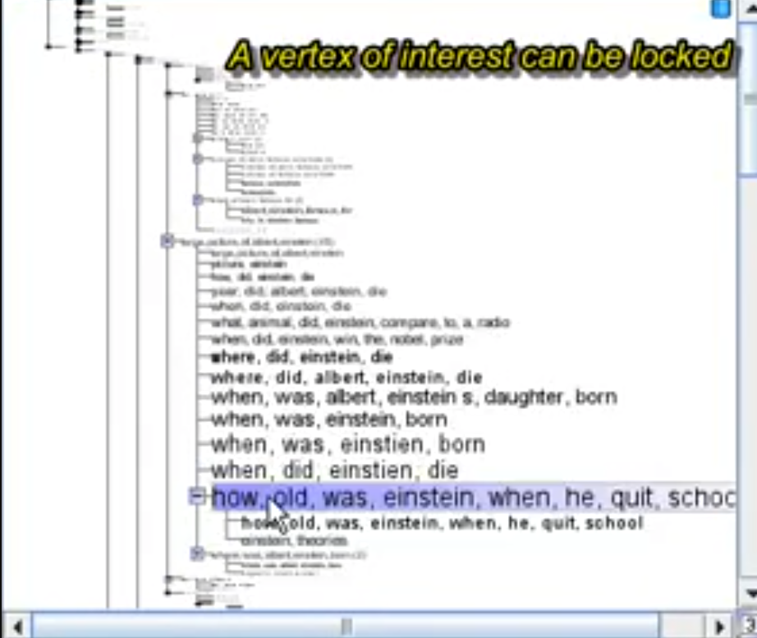
More fisheyes
Fisheyes in trees
https://www.youtube.com/watch?v=mTf7bPvdeJo

Slide 29
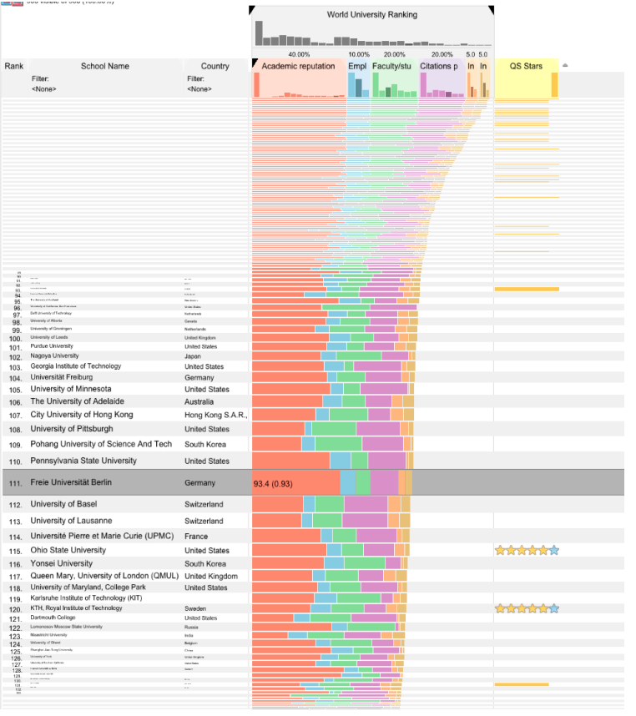
More fisheyes

Slide 30
What could go wrong with distortion?

Slide 31
What could go wrong with distortion
Disrupts relative spatial judgements
Need to ensure the distortion is communicated to the user
Hard to target the distortion effect to a precise target
Lens displaces items
How to move to a target?
Mixed results when compared to separate views

Slide 32
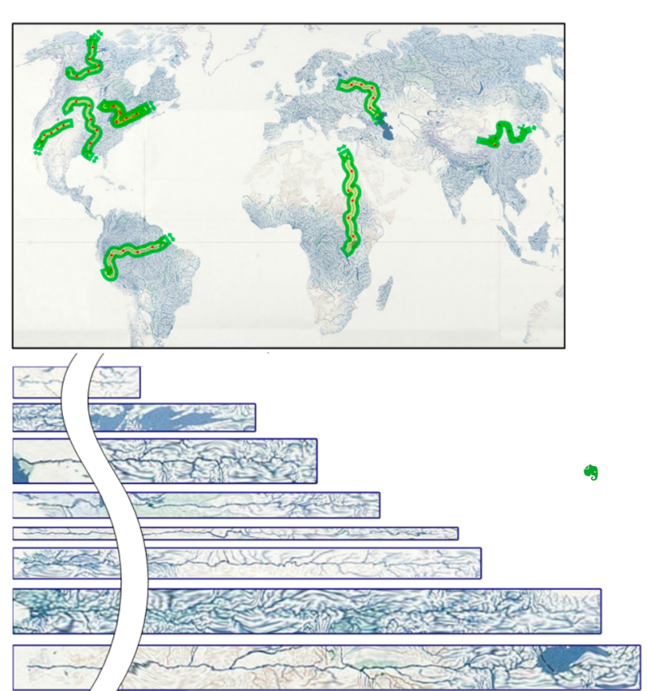
Transmogrification
Select a non-straight zone
Straighten it
https://www.youtube.com/watch?v=S1Roi2NOmx8

Slide 33
Transitions between views/states
When the user interacts and the states of the visualization changes, you can either
Jump to the new state
Create a smooth, continuous change between states
Reasons to have a smooth continuous change- transition
Helps the user keep track of the change
if the graphic changes from one position to another, easier to keep track with a continuous transition
Helps the user build a mental model of the data
This interaction causes this change in the view which arises from a differences in the underlying data

Slide 34
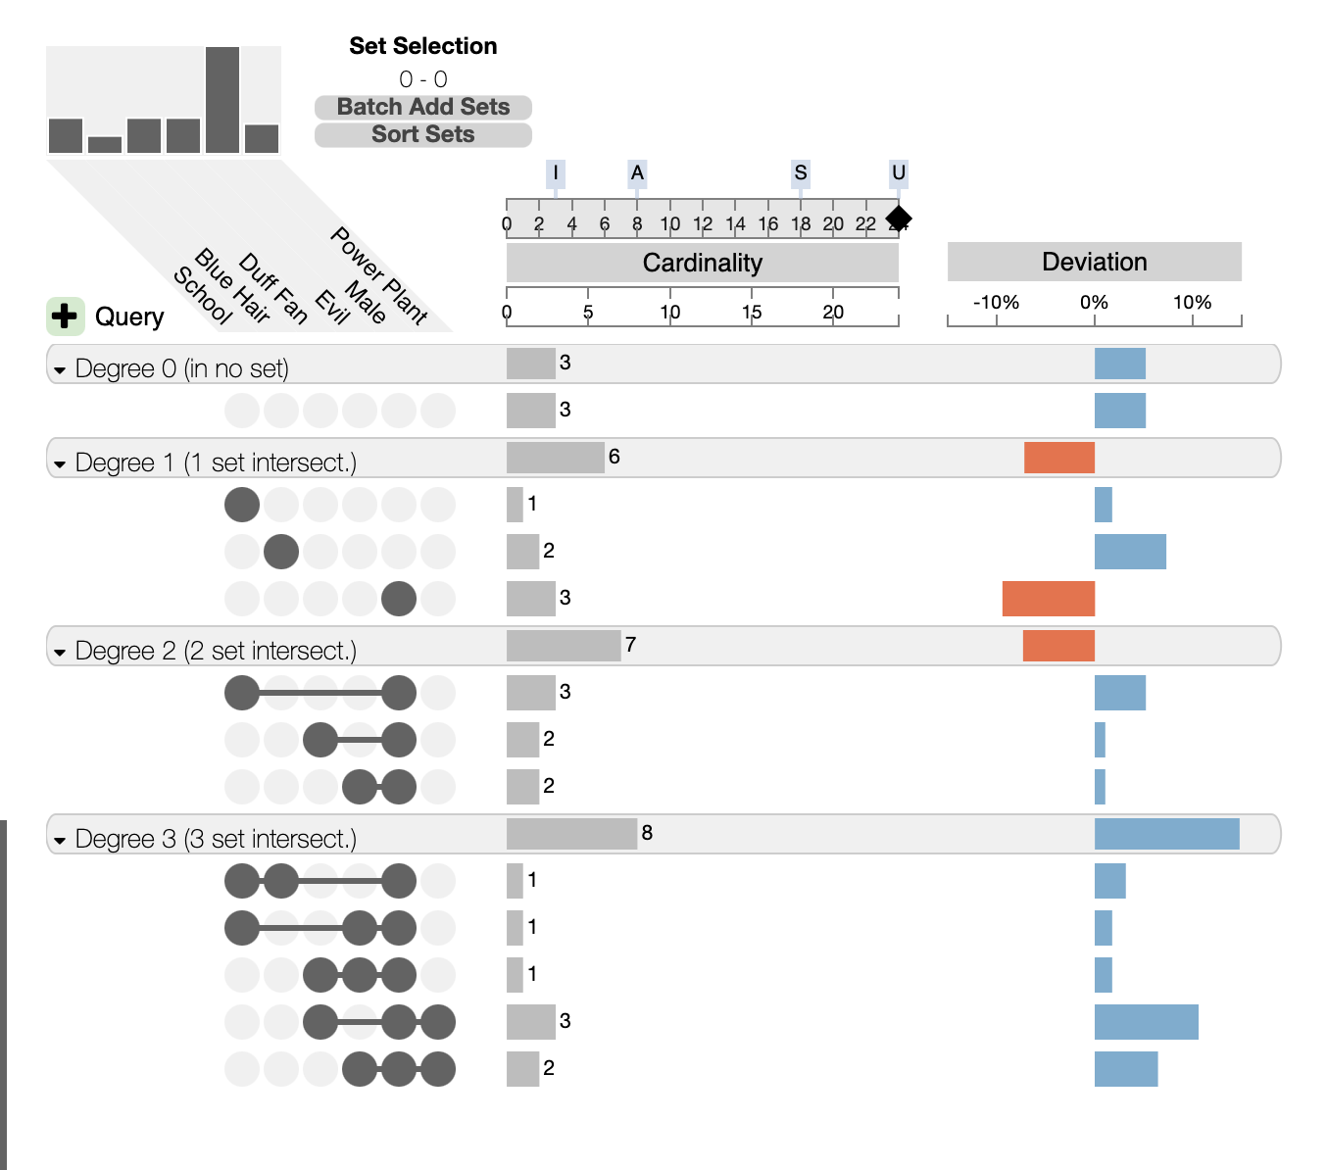
Transitions between states
Transitions to help support building a mental model
Smooth interpolation between states and visualization techniques
Support sense of continuity- can track the changes in the data, following interactions
Example:
When I select one sorted order then another, I understand some items as changing in value
http://vcg.github.io/upset/

Slide 35
https://observablehq.com/@d3/stacked-to-grouped-bars

Slide 36
Are transitions useful?
https://www.youtube.com/watch?v=vLk7mlAtEXI

Slide 37
What are the limitations of animations?
When may it not work?

Slide 38
What are the limitations of animations?
When may it not work?
When you have lots of data points
Too much movement
If the transition isn’t linked to a meaningful change in the data
Tracking changes can be hard
Eyes beat memory

Slide 39
Brushing and selecting
Directly on the visualization
Updates the view by filtering out some of the data
This is a form of ‘dynamic query’
Asking- if I select this item or this range, what will I see?

Slide 40
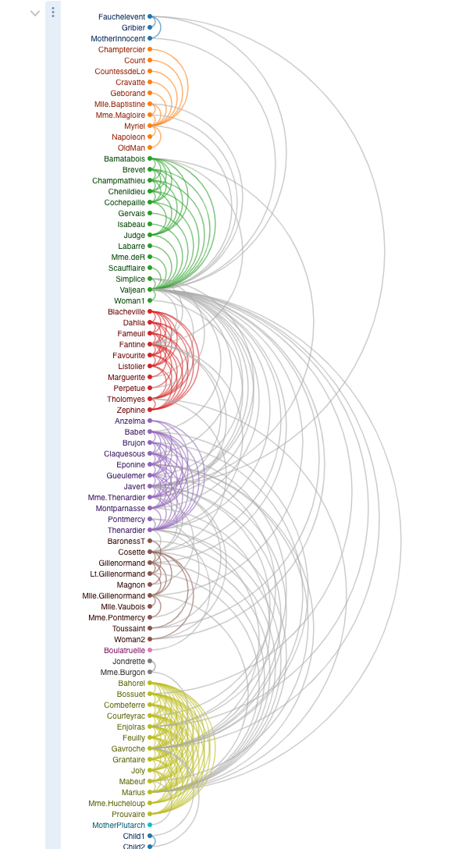
Selecting
https://observablehq.com/@d3/arc-diagram
Arc diagram hard to follow
Add interactions based on selections
Allow user to filter through selection and explore

Slide 41
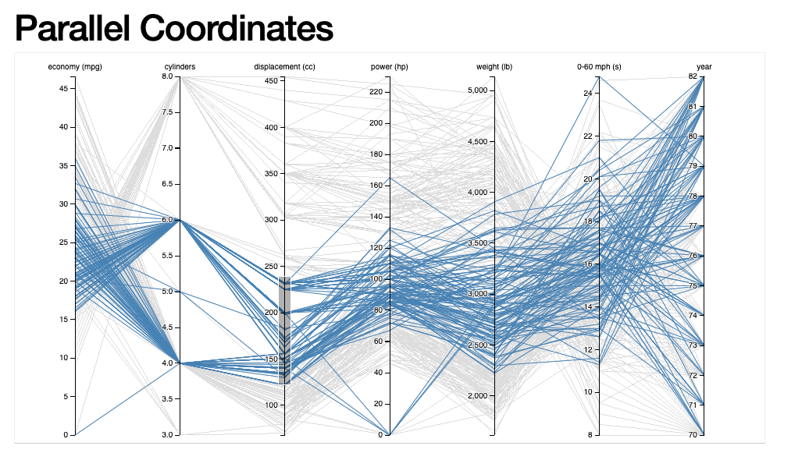
Selecting
https://bl.ocks.org/jasondavies/1341281
Brushable parallel coordinate plots

Slide 42
Brushing and linking
Suppose you have 2+ views of data
One is a timeline
One is a map
The others are bar charts or word cloud showing different aspects of the data.
Let’s say these views are in separate classes
You want to create an interaction where you select a timeframe within the timeline visualization
For instance, suppose you are interested in 1900-1950 datapoints only
All the other charts should update to show the selection
Let’s say they do this by filtering out all the other data, and only showing the selection

Slide 43
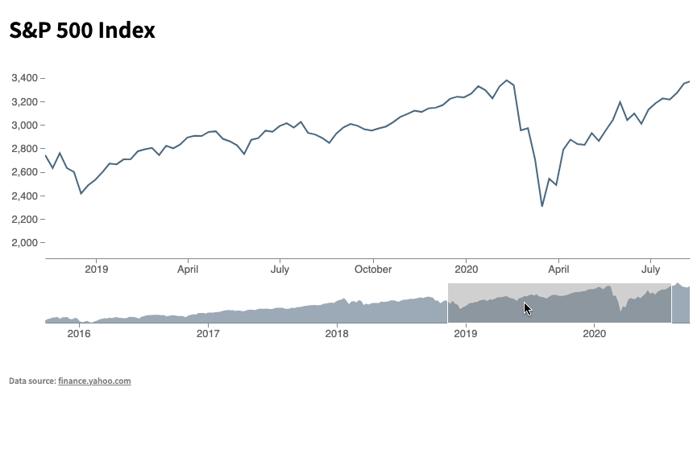
Example
https://codesandbox.io/s/wandering-brook-oqy4ih?file=/js/focusContextVis.js
Caveat- these charts are in one div together…
But we can apply multi-view coordination principles

Slide 44
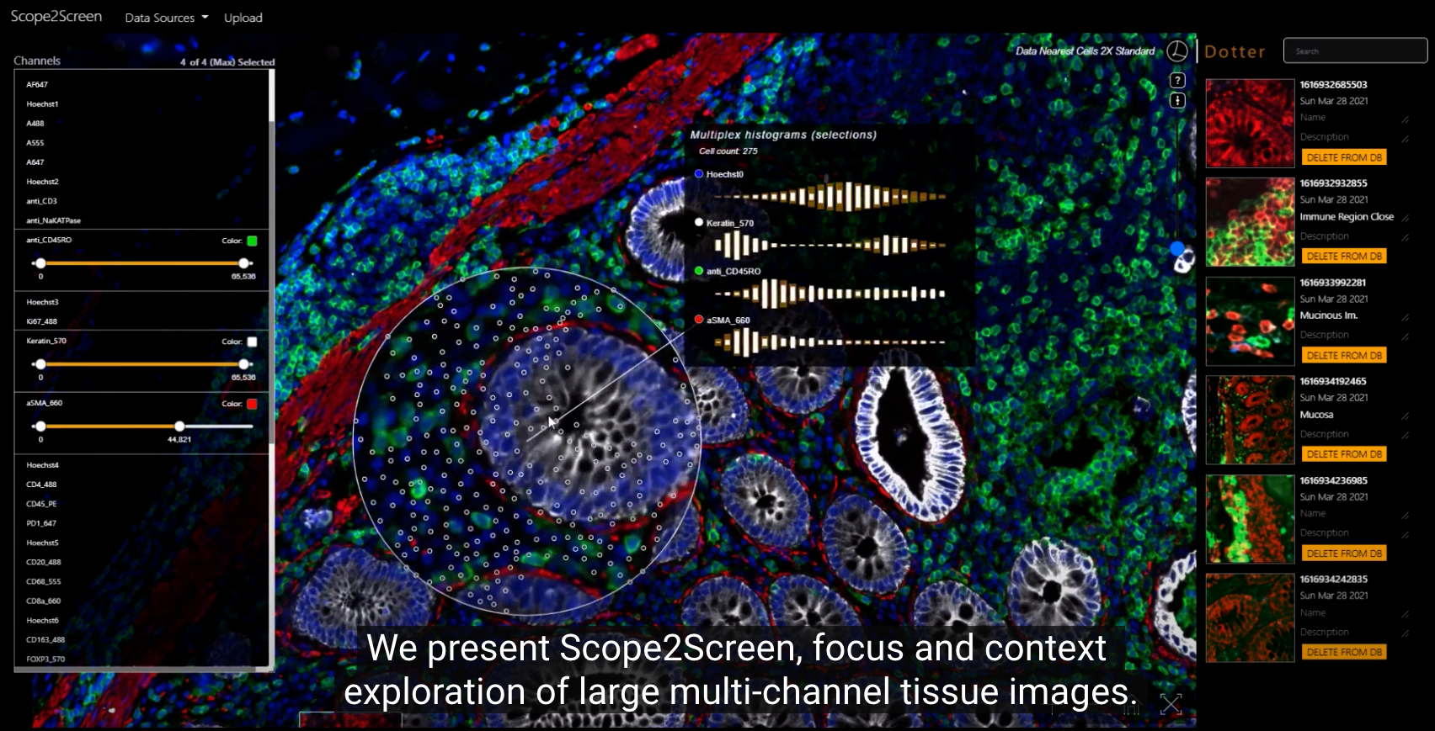
Interactive lens
https://www.youtube.com/watch?v=Y2tGl2r8v6U

Slide 45
Direct manipulation
Consider a car navigation
Direct manipulation
You can see the scene you are navigating through via the window
When you want to turn left, you turn the steering wheel to the left
Your position in the world changes immediately (feedback), and through the window you see the response to your left turn action
Indirect manipulation
You input a degree of turning angle into a form box
You input a direction left or right using a checkbox
You hit a button labeled ‘turn’
Which would you rather do?

Slide 46
Direct manipulation
Features of direct manipulation
Continuous representation of the object of interest
Physical actions instead of syntax
Continuous feedback and reversible, incremental actions
Rapid learning

Slide 47
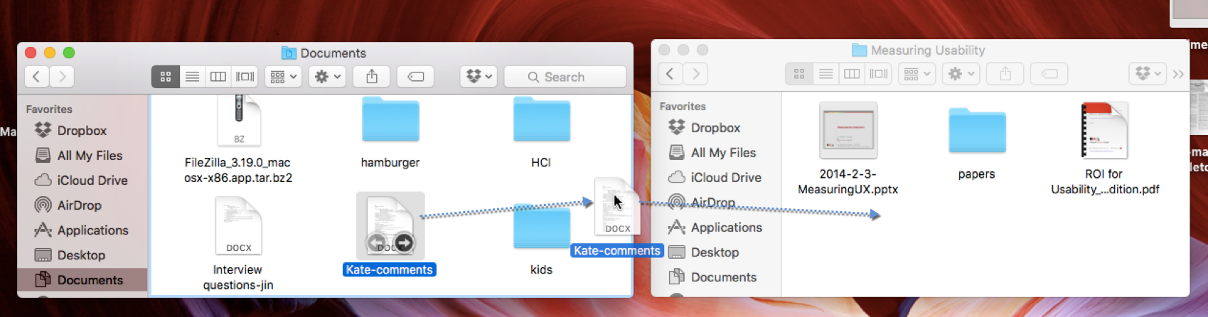
Drag and drop UI’s- direct manipulation?
Is this direct manipulation? Let’s look at the rules
Continuous representation of the object of interest
Physical actions instead of syntax
Continuous feedback and reversible, incremental actions
Rapid learning

Slide 48
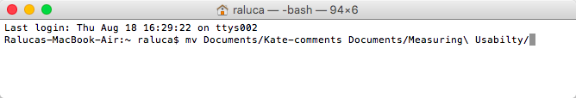
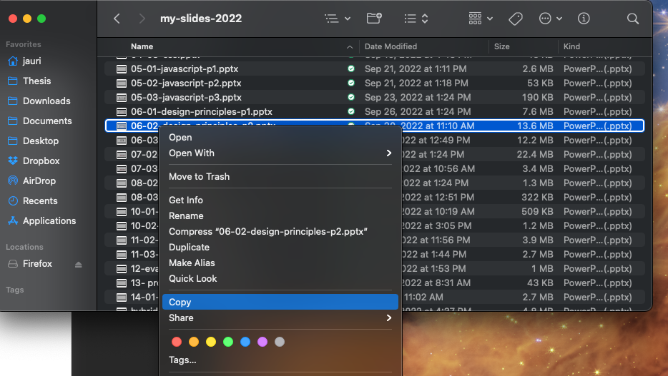
Direct manipulation?
Is this direct manipulation? Let’s look at the rules
Continuous representation of the object of interest
Physical actions instead of syntax
Continuous feedback and reversible, incremental actions
Rapid learning

Slide 49
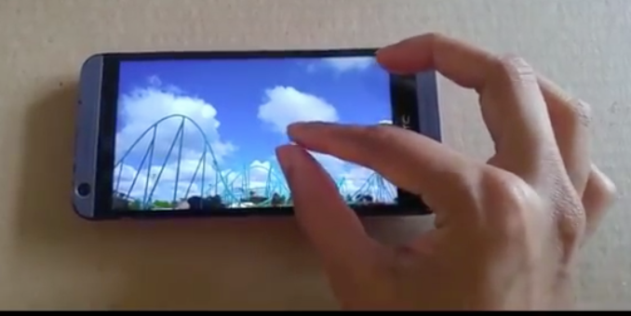
Direct manipulation in UI design
Pinch touch gesture, image zooms in

Slide 50
What are the benefits of direct manipulation
Consider drag and drop vs command line (mv file1.txt folder/.) file manipulation
What are some reasons drag and drop may be more usable?

Slide 51
Direct manipulation benefits
Features of direct manipulation
Continuous representation of the object of interest
Gives you immediate visual feedback
Physical actions instead of syntax
Recognition vs recall- don’t have to remember a command
Continuous feedback and reversible, incremental actions
Error recovery

Slide 52
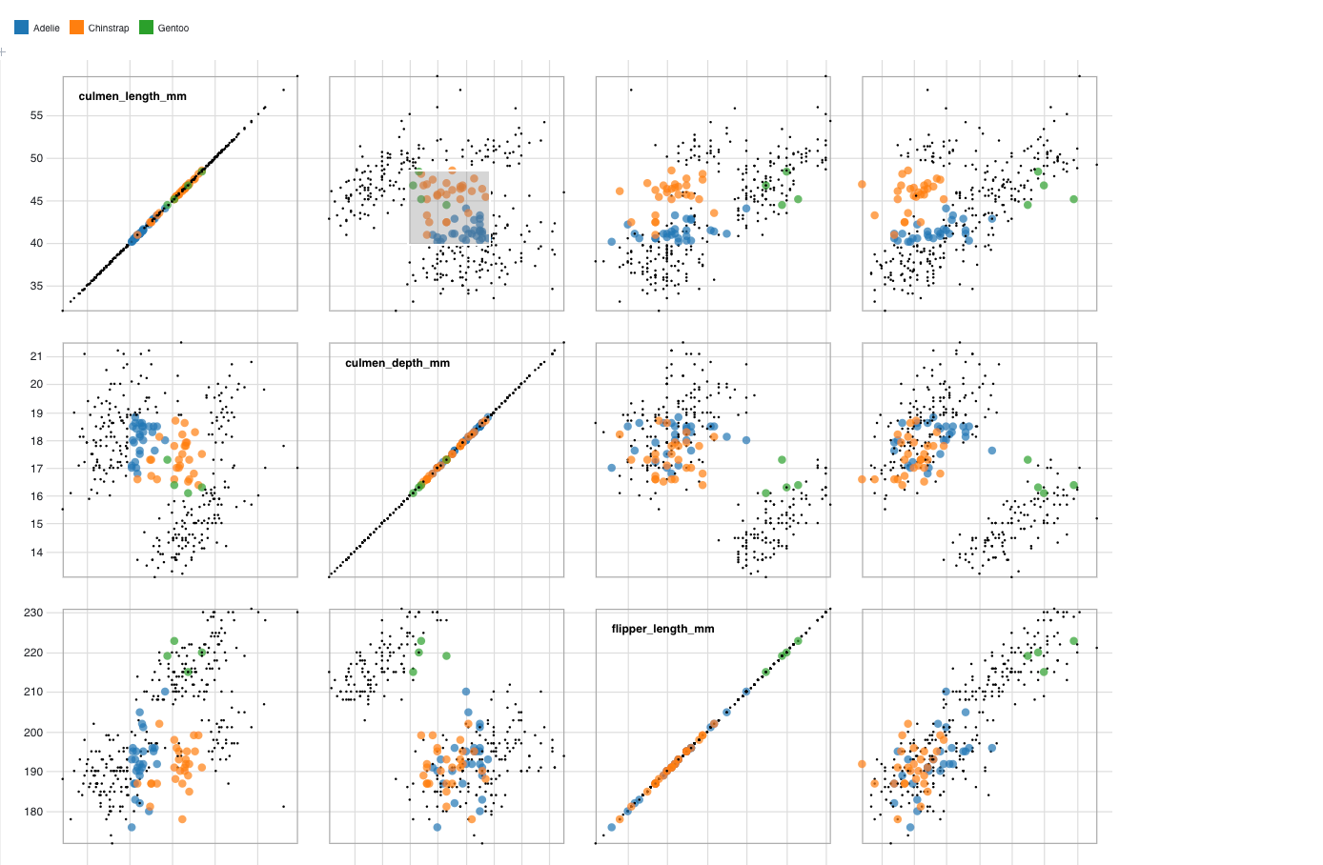
Direct manipulation
Interact directly with the visualization
Vs indirectly through a UI
Actions that are continuous and directly move, resize elements on the screen
Your actions result in continuous feedback and updates
Compare to using a typing query, selecting from UI options or a moving slider
Why is direct interaction better?
Example: https://observablehq.com/@d3/brushable-scatterplot-matrix

Slide 53
Interaction design, re-design activity
We are going to re-design this visualization
First let’s watch it, and discuss some of the drawbacks of the early approach
https://www.youtube.com/watch?v=5X8XY9430fM

Slide 54
What are some disadvantages of the “query interface”
https://www.youtube.com/watch?v=5X8XY9430fM
Like amazon and other interfaces
You have a GUI with buttons that allow you to input your preferencs
What are some disadvantages?

Slide 55
What are some disadvantages of the “query interface”
https://www.youtube.com/watch?v=5X8XY9430fM
Like amazon and other interfaces
You have a GUI with buttons that allow you to input your preferencs
What are some disadvantages?
Can’t see how many elements are within the selections
Indirect manipulation (selecting the addresses) vs direct manipulation

Slide 56
Re-design
Your data is current houses for sale in the Cincinnati metro area
Price
Numbers of bedrooms
Number of bathrooms
Square footage
GPS locations
Has/Does not have a
Garage
Pool
Basement
Tasks:
Users specify which areas they are interested in – such as distance to workplaces
Users select their criteria for houses (price under $300,000, with 3 or more bedrooms)
Users see which houses fit the criteria, can get details on demand
Sketch designs for your new visualization. Consider:
Multiple linked views
Direct manipulation

